Slide 1



Slide 2

What are enterprise skills?
Problem solving
Leadership
Resilience
Teamwork
Determination
Communication
Creative
Confidence

Slide 3



Slide 4
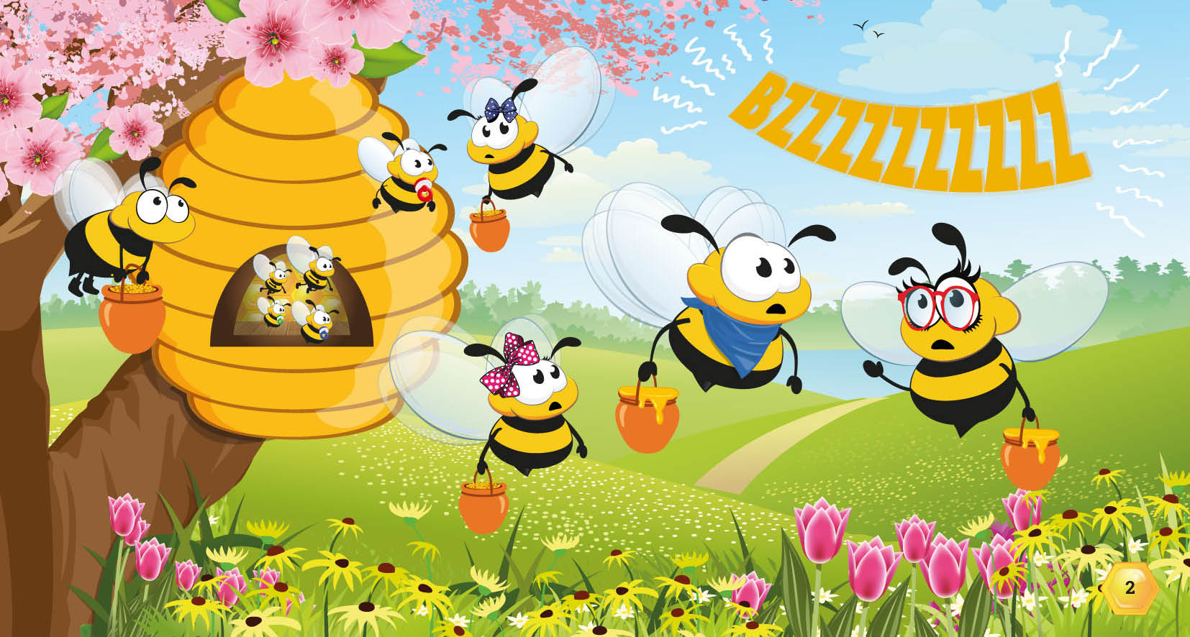

Slide 5
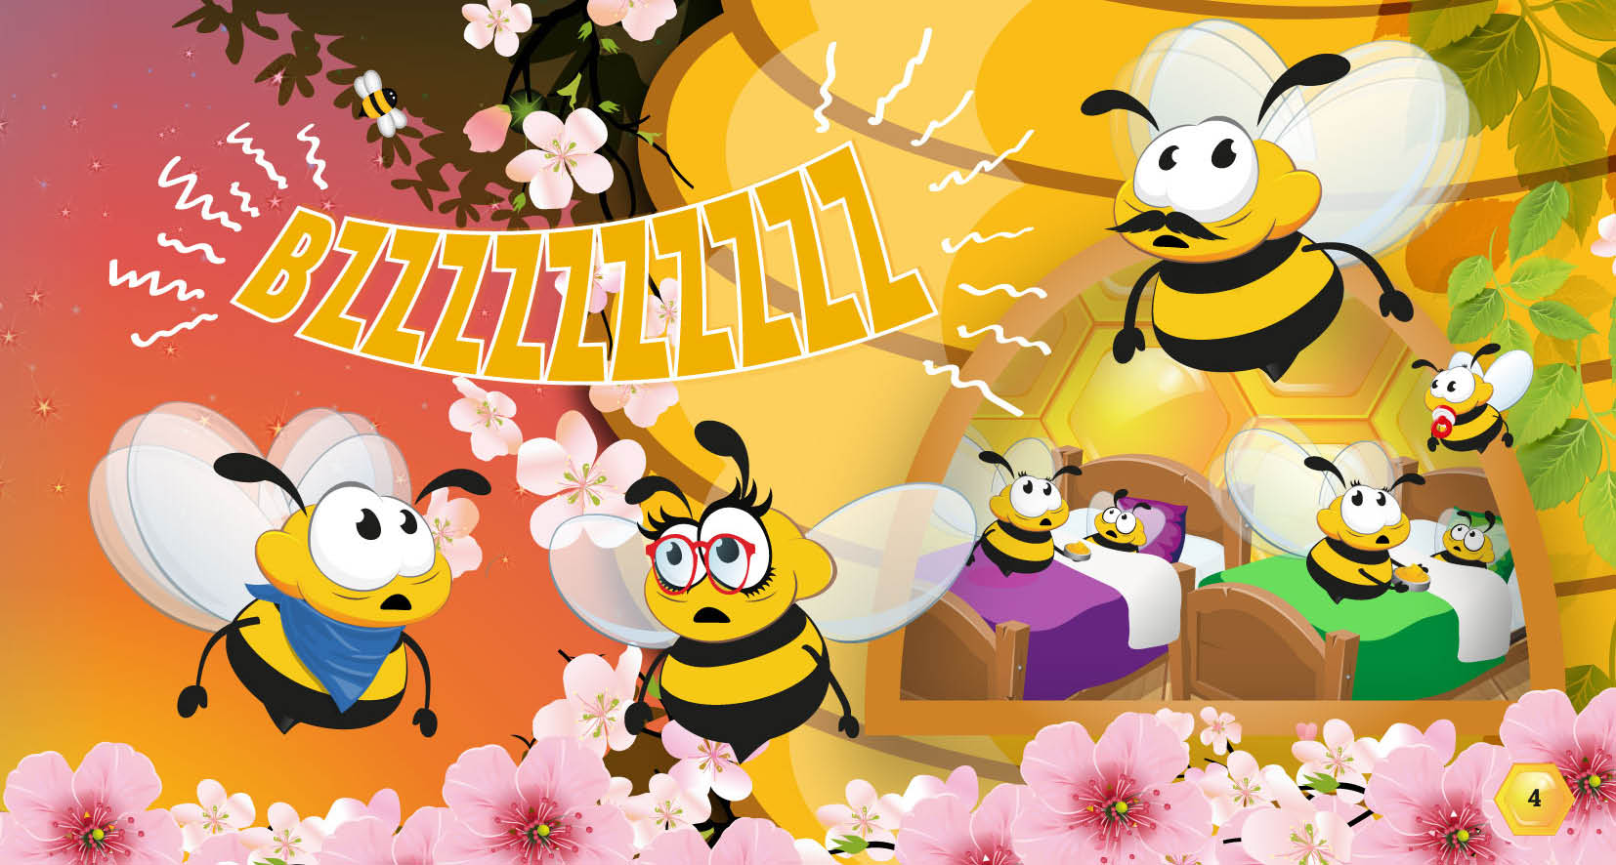

Slide 6
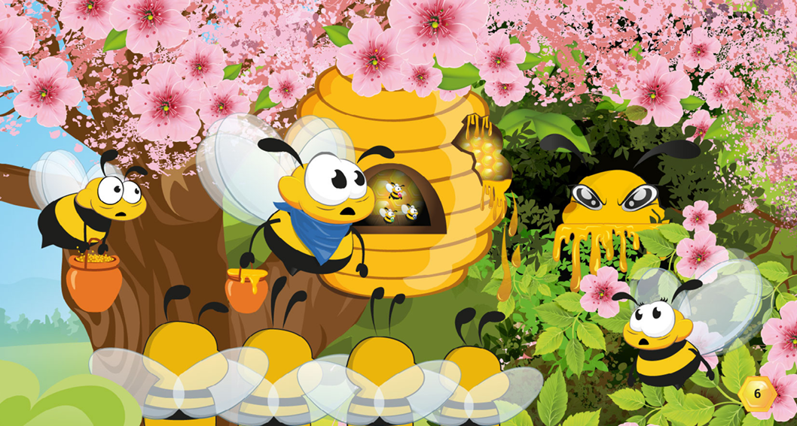

Slide 7
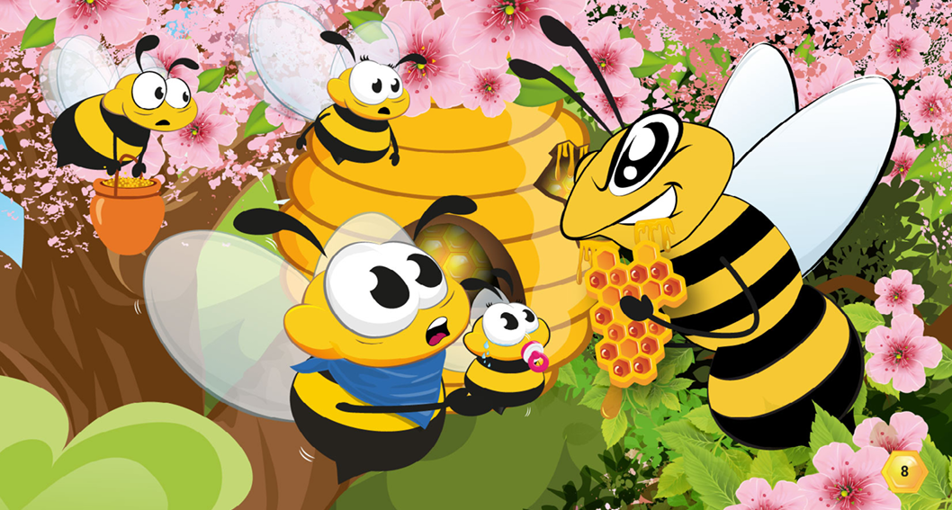

Slide 8
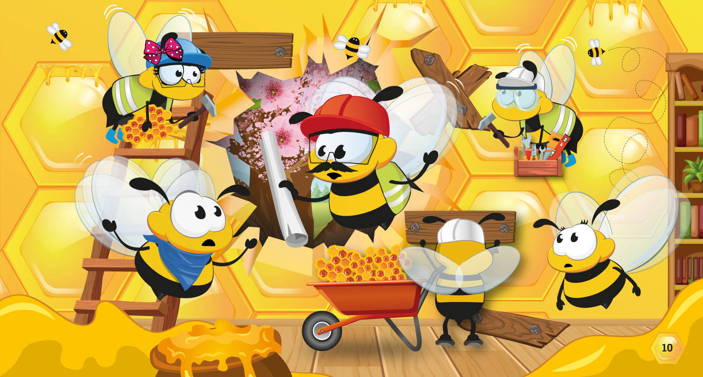

Slide 9
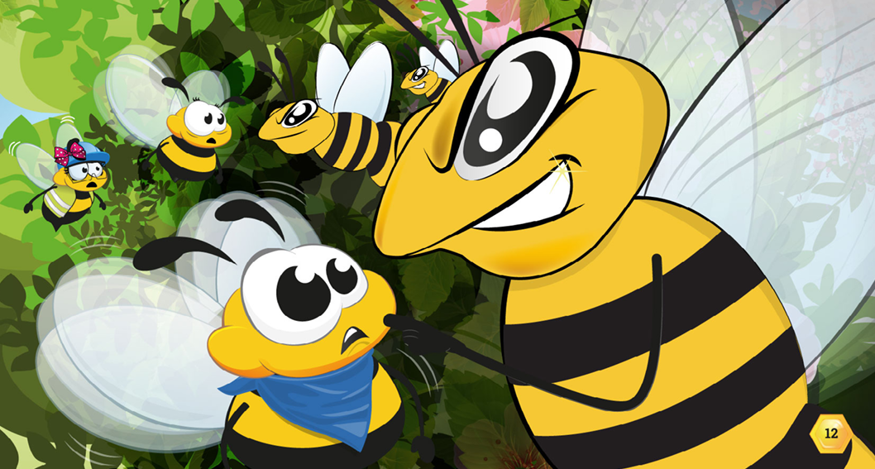

Slide 10
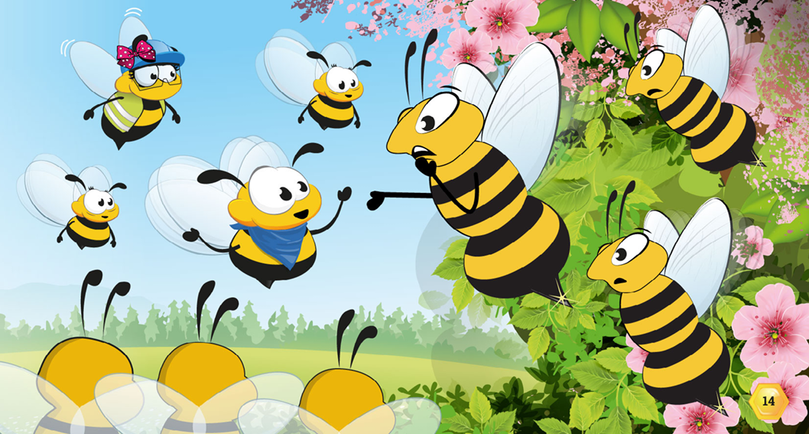

Slide 11
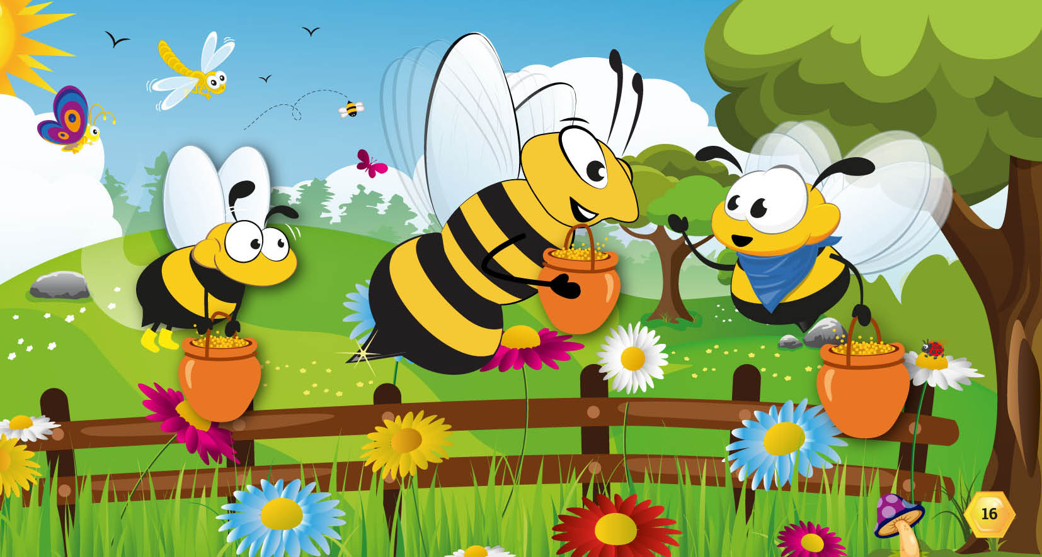

Slide 12
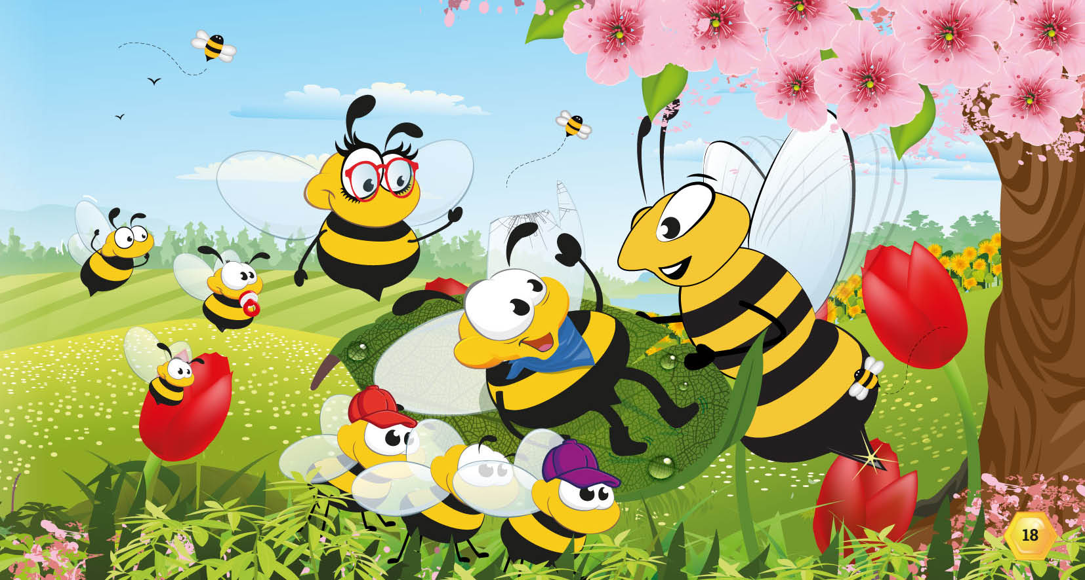

Slide 13
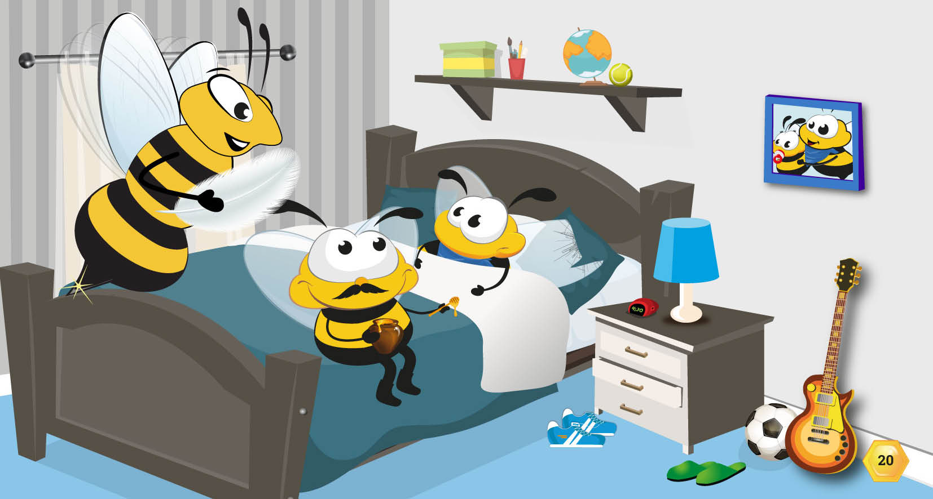

Slide 14
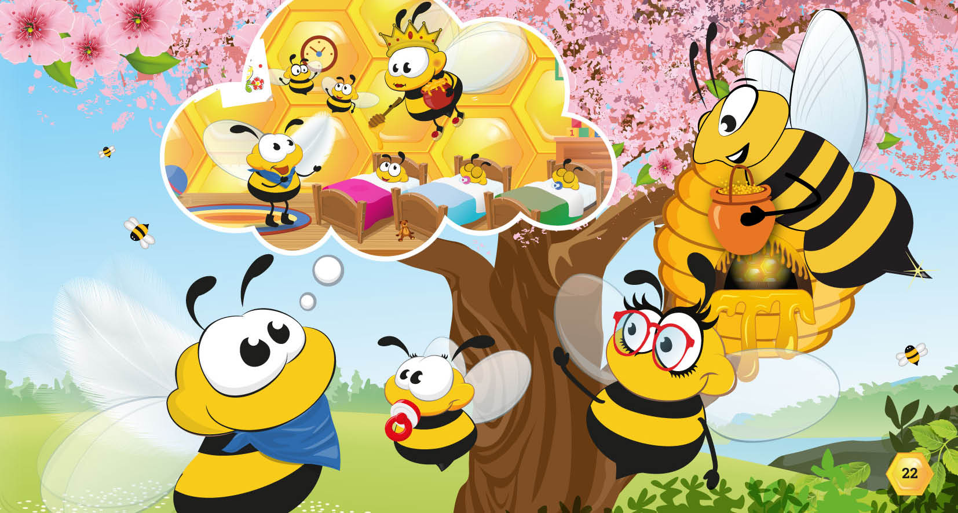

Slide 15
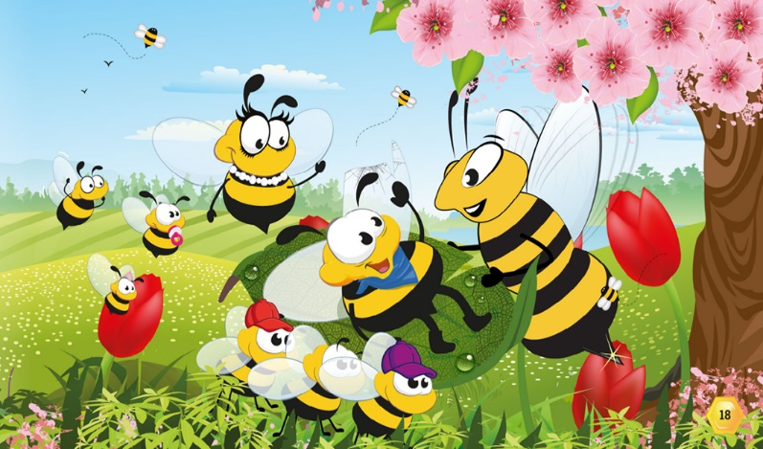

Which enterprise skills did Bertie practise in the story?
Communication
Problem Solving
Determination
Teamwork

Slide 16
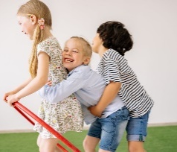
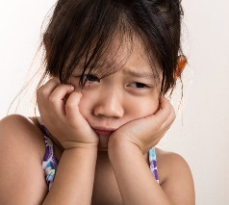

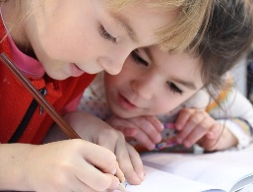
A Good Friend…
Play the ‘Thumbs up/Thumbs down Game’.
Look at the picture cards and decide whether the picture shows a good friend. If it does, put your thumbs up.
If it doesn’t show a good friend, then put your thumbs down.
Notes:
Don’t use all the cards, save some for the end of the session.

Slide 17
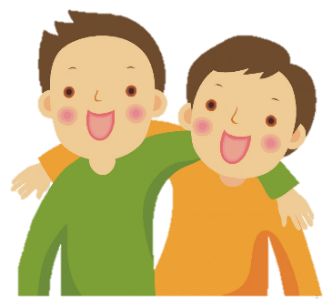
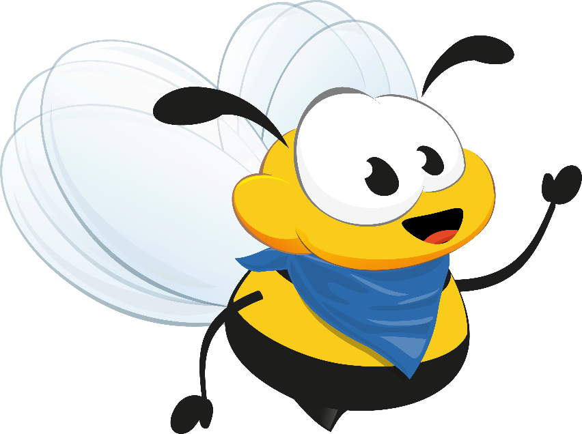
What do you think makes a good friend ?
I wonder what makes a good friend?
Close your eyes and think of one of your friends.
When you open your eyes share with the class why you think they are a good friend to you.

Slide 18
The Compliment Game
What is a compliment?
A compliment is something nice you say to praise someone…
You look lovely today.
You make me smile.
You are so funny.
You are very kind.

Slide 19
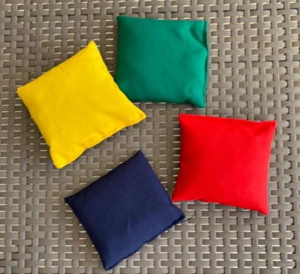
The Compliment Game
Work in groups of 6/8.
Sit/stand in a circle and pass the beanbag to someone in group and give them a compliment. (Focus on the things that make them a good friend).
Make sure each person gets to give and receive at least 1 compliment.
You are a great friend!

Slide 20
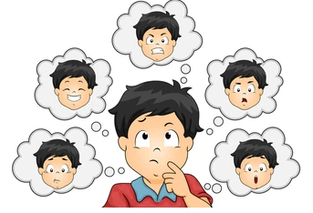
How has it made you feel hearing the nice things your friends have said about you?
Surprised
Loved
Confident
How does it feel sharing nice things about others?
Warm and
Fuzzy
Proud
Happy

Slide 21
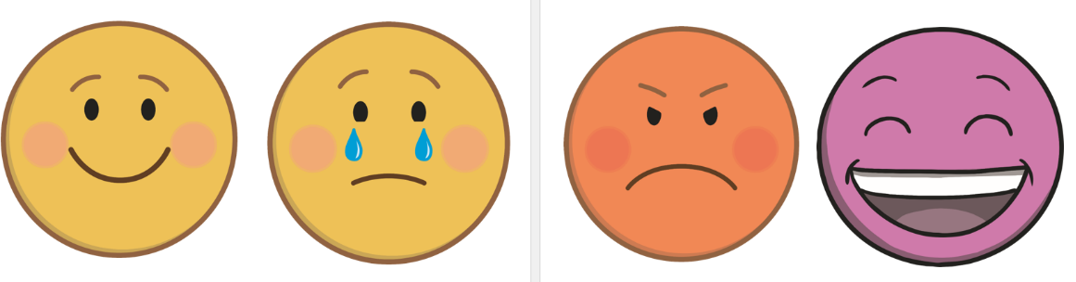
Friendship and Feelings
Sitting in your groups, choose a feelings card from the middle of the circle and play ‘pass the feeling’.
Make sure you play the game with each of the feeling's cards.
Think about the different feelings cards and discuss what situations with friends might make you feel that emotion.
Examples:
I might get angry if a friend pushes me over.
I might get excited if a friend shares their toys with me.

Slide 22

What have we learnt today about being a good friend?
Be kind
Be helpful
Be caring
Be honest
Be thoughtful

Slide 23

Remember to always BEE a
good friend!
Challenge…
To give two compliments to two different people by the end of today?
Notes:
Repeat after you to get these ideas in their heads.

Slide 24
Which enterprise skills did we practise today???
Confidence
Teamwork
Determination

Slide 25
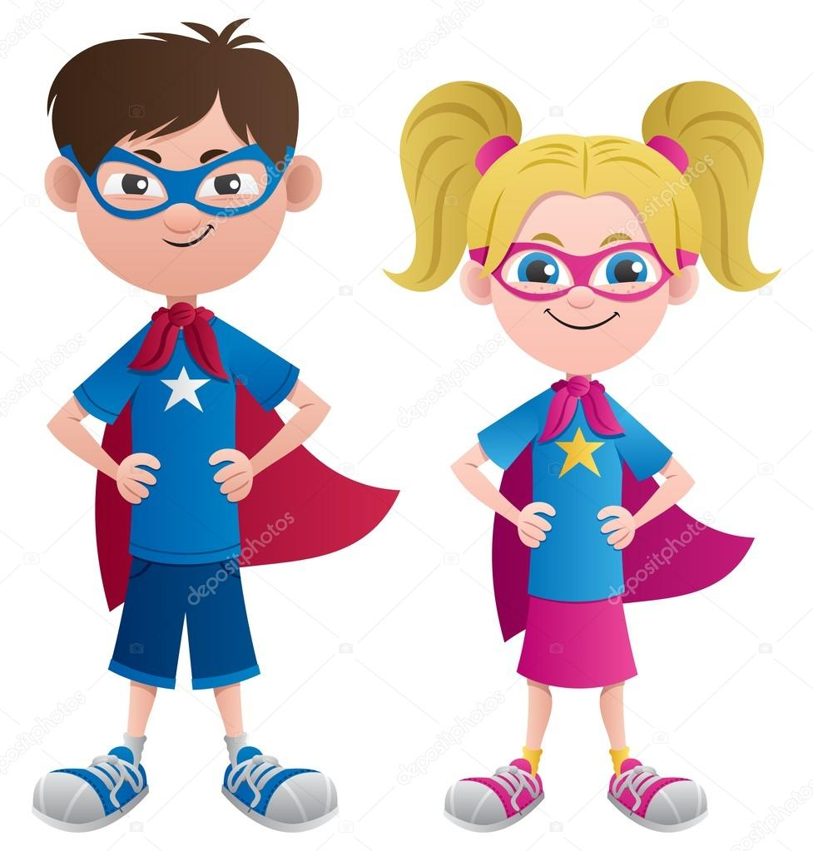
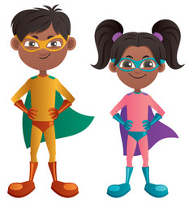
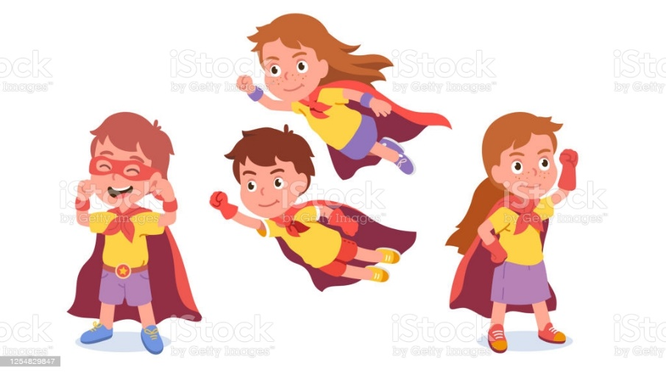
Positive Affirmations
I am STRONG
I am BRAVE
I am KIND
I am CONFIDENT
Notes:
Repeat after you to get these ideas in their heads.

